Slide 1
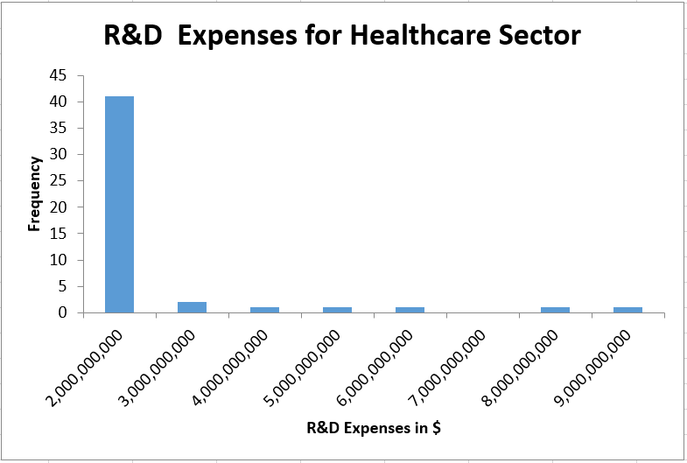
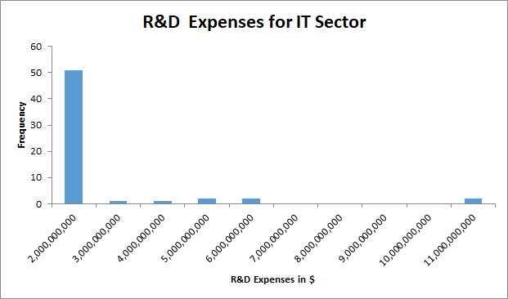
Does the healthcare sector have similar expenditure levels for Research and Development as the IT sector?
Here are the histograms for the annual R&D expenses for Healthcare and IT sector companies reported for all companies.
Both distributions are right-skewed or positively skewed. That means, the mean for each is higher than the median.
The mean for healthcare is about $995 million, and for IT is slightly above at $1.2 billion. However, the median for IT is double ($590 million) the median for healthcare ($284 million). The standard deviation for IT is also slightly more ($2.2 billion for IT and $1.8 billion for healthcare companies). That means, the variability in R&D expenses for IT companies is higher, with more companies spending above $9 billion, and more than 50% of the IT companies spending more than $590 million that year on R&D expenses.

